Slide 1
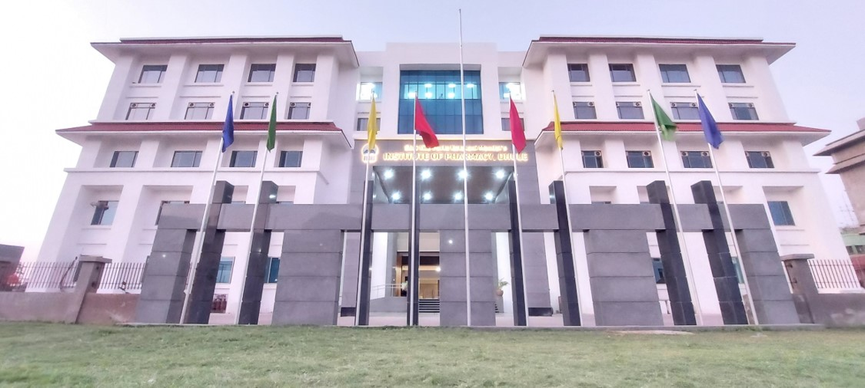
SVKM IOP DHULE
Precede.Pursue.Preeminence
Shri Vile Parle Kelavani Mandal’s
Institute of Pharmacy, Dhule
Approved by AICTE, PCI, DTE
Affiliated to DBATU, Lonere, MSBTE, Mumbai
Placements
2022-2023

Slide 2
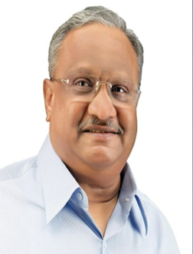
Message from our President
Shri. Amrishbhai R. Patel
Pharmacy Education is transforming itself to keep abreast to the relevant changing times. Therefore, the focus, apart from ensuring employability, is to prepare our students into holistic professionals. SVKM’s Institute of Pharmacy, Dhule believes in the wholesome growth of our students: it facilities every opportunity and facility to unleash their talent. SVKM’s IOP is fully aware that Industry-oriented education will ensure better employment opportunities to young Pharmacist.
I am happy that our institute has responded positively to the current trends in job market to enable our students for industry ready through the process of learning, unlearning and re-learning. This process helps to fill the gap between academics and industries. Further, this will foster the meta-cognitive abilities and much needed hard and soft skills to carve a niche.
Heartiest Congratulations to all the students who are successfully placed in various companies.
I wish our students all the best for coming placement drive.
Shri. Amrishbhai R. Patel
President

Slide 3
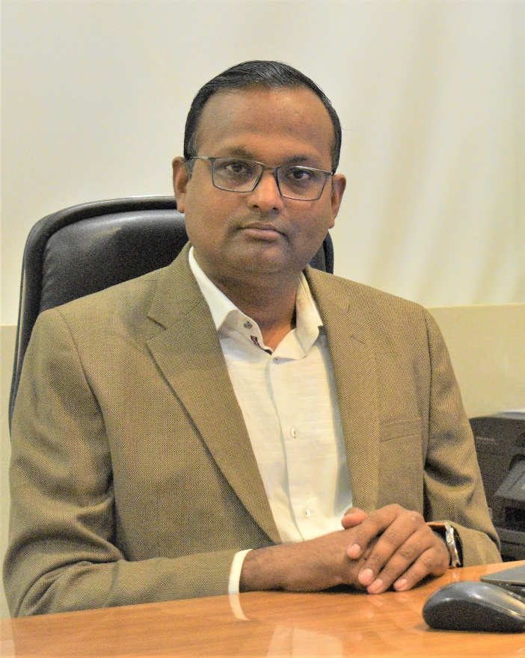
Message from the Principal
Dr. Sameer N. Goyal
I am honored and delighted to introduce you to SVKM's Institute of Pharmacy, Dhule. The Institute was established in the year 2017 at Dhule with the purpose to impart Pharmacy education to tap the talent of the area and to equip them with employability. Thus, it has continued its great educational legacy through its motto: Pursuing Excellence Through Education. I also feel privileged to Welcome the Students as the Stake Holders who will uphold the Banner of SVKM’s IOP high and continue to sustain the excel stature of the Institute.
Our institution has ultra-modern infrastructure facilities, laboratories with sophisticated instruments, highly learned and experienced faculties and enthusiastic students as our strength. Apart from curriculum, the institute invests eﬀorts in soft skills, aptitude and technical training of the students to make them industry ready in every aspect. This makes our students most sought after in industry. We have collaborated through MOUs with several industries to tap the young talent. Therefore, we confidently invite you to oﬀer the best human resources with at par knowledge and competitive skills to be an asset to the esteemed organization of yours.
We feel proud that our students are well-groomed with the finest educational and training facilities to achieve excellence in their chosen field. We nurture our students in an environment that ensures rigor, encourages teamwork and stimulates excellence. We develop our students with the best Pharmacy education and practical exposure.
I wish a very successful career to all the students and extend a very warm welcome to all the prospective recruiters for campus placement.
Dr. Sameer N. Goyal
Principal

Slide 4
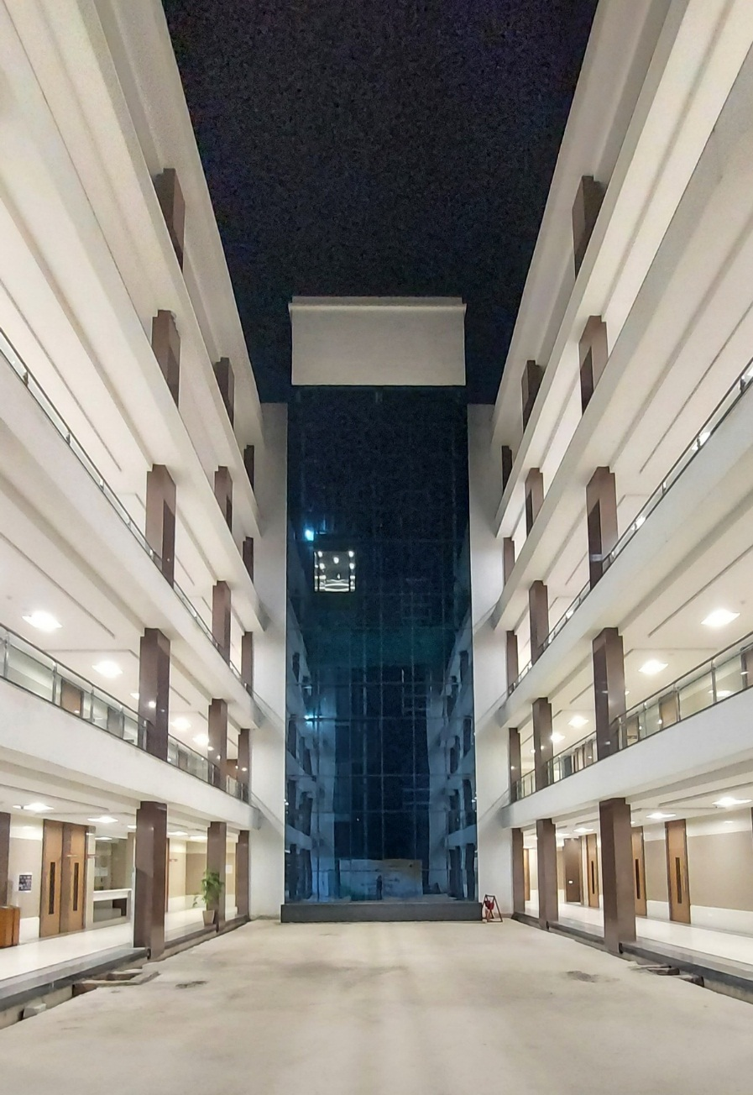
Appendix
SVKM IOP DHULE
Precede.Pursue.Preeminence
SVKM at Glance
Life at SVKM IOP, Dhule
Alumni network
Bulletins
Placements
Contact Us

Slide 5
SVKM at Glance
1961
SVKM’s Mithibai College of Arts, Chauhan Institute of Science, Mumbai
1963
SVKM’s Shri Bhagubhai Mafatlal
Polytechnic, Mumbai
1964
SVKM’s Narsee Moonje College of
Commerce & Economics, Mumbai
1977
SVKM’s Jitendra Chauhan College of
Law, Mumbai
Our flagship campus at Pilani(Rajasthan) was setupin1964”
1981
SVKM’s NMIMS, Mumbai
Deemed to be University
1994
SVKM’s Dwarkadas J. Sanghvi
College of Engineering, Mumbai
2004
SVKM’s Dr. Bhanuben Nanavati
College of Pharmacy, Mumbai
2006
SVKM’s NMIMS, Shirpur Campus

Slide 6
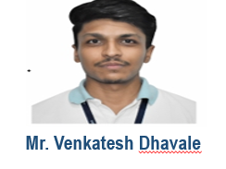
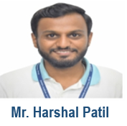
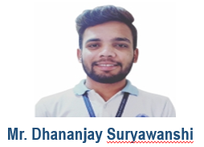
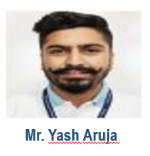
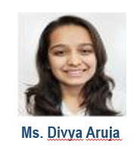
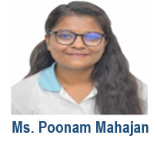
Alumni Network
Compensation: ₹ 4.0 LPA
VTech Solutions
Compensation: ₹ 3.6 LPA
Compensation: ₹ 3.4 LPA
Ms. Radhika Sharma
Mr. Himanshu Girase
Ms. Vaishnavi Buwa

Slide 7
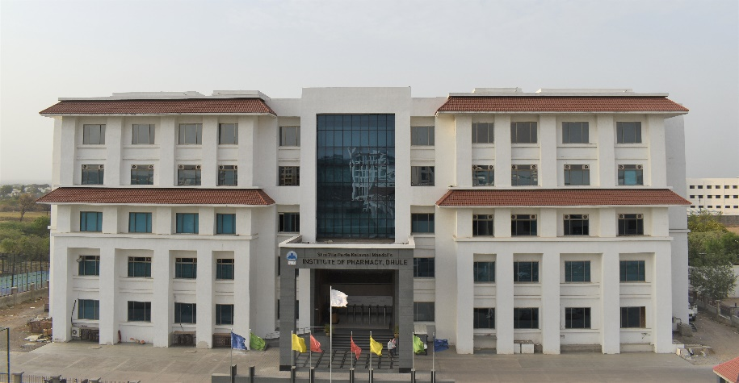
Life at SVKM’s Institute of Pharmacy, Dhule
SVKM IOP, Dhule was established in 2017. Despite being recent, this campus is an absolute exception. We are supported by state-of-the-art facilities and competent expertise. Institute is approved by AICTE, PCI, DTE and is affiliated with DBATU. We not only provide high-quality teaching but are underpinned by cutting-edge research in the pharmaceutical sector.
VISION
To pursue excellence in pharmaceutical education and research to develop competent professionals.
MISSION
To impart quality pharma education that leads to a self-reliant student community through efficient faculty and state-of-the-art infrastructure.
To inculcate professional skills to cater the current needs of Pharmaceutical Industry.
To develop centre of excellence in pharmaceutical research and training.
To nurture holistic development of pharmacist contributing to socio-healthcare system.
SVKM IOP DHULE
Precede.Pursue.Preeminence
“We built the future with the pursuit of knowledge”

Slide 8
Program of studies
SVKM IOP DHULE
Precede.Pursue.Preeminence
Whether you are after career progression, skill enhancement or just love to learn, courses offered at SVKM IOP, Dhule could be for you.
“Our courses are designed to pursue excellence”
Courses offered
Diploma in Pharmacy
(Intake 60)
Bachelor of Pharmacy
(Intake 100)
Master of Pharmacy
(Intake 48)
These programs are tailor made to train the students to play an important role in community pharmacy and assist the Pharmaceutical industry at various levels. These courses are predominantly based on practice and interaction with a strong focus on the healthcare system. This will enable students to practice pharmacy profession in a strong, skillful and determined manner.

Slide 9
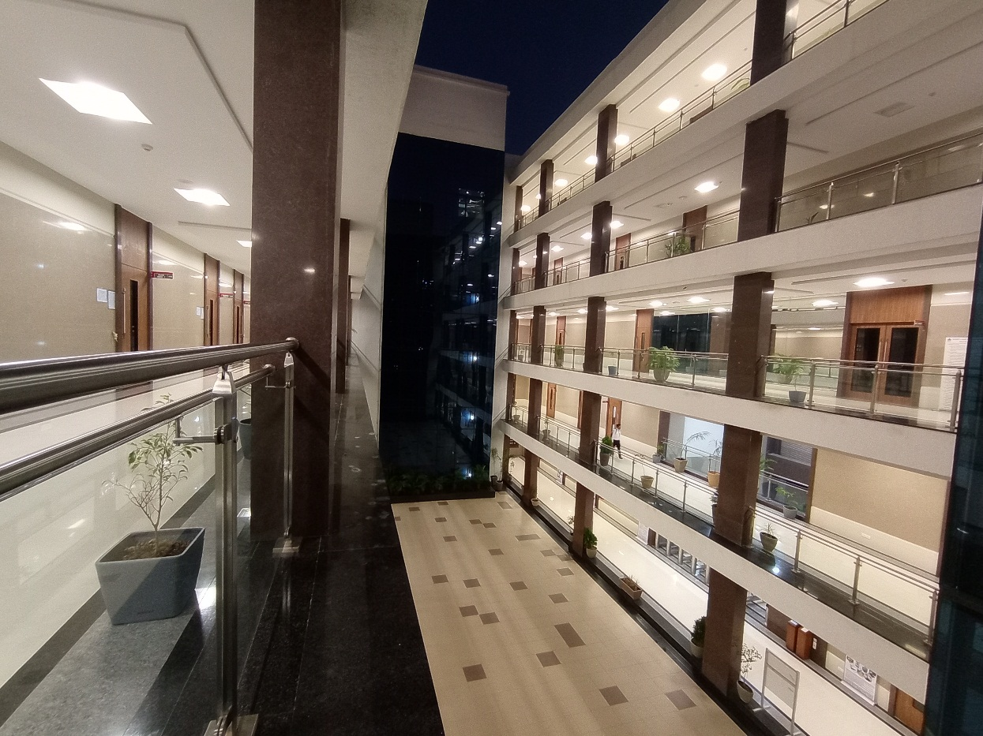
SVKM IOP DHULE
Precede.Pursue.Preeminence
“Where everything is about you…”
INFRASTRUCTURE FACILITIES
Wi-Fi Campus
Digital Classrooms
Digital Language Lab
Centralized AC
Local Guardian System
FACULTY
Highly qualified faculty
340 Publications
More than 20 Patents filed by Faculty
1.5 Cr (Approx.) Research Grants
INDUSTRY CONNECT
MoU’s with industries
Industrial Visits
Experties Talks
Sponsored Projects
STUDENTS ACHIEVEMENTS IN ACADEMIA
2021 batch 14 GPAT Qualified Students Highest GPAT Result in DBATU | 2022 batch 17 GPAT Qualified Students Highest GPAT Result in DBATU

Slide 10
SVKM IOP Placements
We want to help empower you to go on to succeed in your chosen career. That’s why the institute’s Training and Placement Organization (TPO) is there for you. It provides dedicated career support that is tailored to your chosen subject to help you develop a competitive edge. Throughout your time with us, the TPO team aims to build your confidence, enhance your CV and provide access to the best graduate jobs.
Pharmaco-vigilance and
BPS
Medical Coding and Clinical Trial
Sales and Marketing
Core Pharmacy & Production
Quality Control
Quality Assurance
SVKM IOP DHULE
Precede.Pursue.Preeminence
“We not only offer you the chance to gain a solid foundation but also the ethical growth for potential career.”

Slide 11
Activities of Placement Cell
Pre-Placement
Aptitude Test Training
Soft Skills Training
Mid-Placement
Recruitment Process
Post- Placement
Results
On Boarding
Communications Skills
Mock Interviews
Sessions by Industry Expertise
GPAT Preparation Session
Follow-Up on Students
Aptitude Test Analysis and Report
Execution
Mock PI
Counselling
Reports
Connect with Work
Motivation & Guidance
SVKM IOP DHULE
Precede.Pursue.Preeminence

Slide 12
Placement Process
The Placement process at SVKM’s IoP is students' centric and is well managed by Training and Placement Cell. The team manages the complete placement process right from Interaction with Companies/corporates, to sending of students batch profiles and CV's, to arranging Pre-placement talks with companies, to coordinating with companies for all selection process till the final selection. The Entire Placement Process aims to match the requirements of the Corporate through educational excellence, innovative research and social outreach programs by making available Our Talent pool to the corporate. The Campus has an excellent infrastructure and all the facilities required to host a Campus drive to the satisfaction of the recruiters.
Furthermore, We Can arrange for all the virtual means too, like GD/PI on MS Teams,
Webex, Zoom, and other online modes, including Google meets, Video calls on WhatsApp, Hangouts, Google Duo, etc.
Final Placements :
Final Placements for batch commence in the 8th Semester of their course, which enables the graduates to acquire all necessary skills required to face the outer world and the corporate challenges. Students starts their interaction with companies July onwards, to understand the recruitment cycle from various recruiters. The Selection/Campus drive this year will commence from December 2021 and post selection the students will be available to join the corporates from July 2022 onwards, post completion of their Final Exams.

Slide 13
Our Recruiters

Slide 14
Collaborations

Slide 15
Placement Details for 2021 Batch
75
Placement offers received
Highest Salary in LPA
3.60
Average Salary in LPA
2.33

Slide 16
Placement Details for 2022 Batch
119
Placement offers received
Highest Salary in LPA
4.00
Average Salary in LPA
2.76

Slide 17
Placement Statistics
Total Students
Interested Students
2021-22
Sector Wise Placements
Placed Students
% Placement
US Health Care Recruiter Production and Manufacturing Sales and Marketing
Pharmacovigilance Hospital Pharmacy Medical Writing
87.06%
74
73.61%
53
72
85
16%
3%
10%
123
94
35%
22%
2021-22
2020-21
120
119
14%
100
80 75
60
40
20
10
11
3.6 4
2.3
2.56
0
Highest
CTC LPA
Average
CTC LPA
Total Offers
No. of Companies
2020-21
2021-22

Slide 18
Employability Enhancement Training Programs | 2023 Batch
Training Partner | Objective of Program | No. of Hours
Campus Credentials | Aptitude Skill Enhancement | 90 Hrs
Rubicon Skill Development Pvt. Ltd. | Soft Skill Enhancement | 20 Hrs
Global Talent Track (GTT) | Corporate étiquettes, GD, Interview Skills | 20 Hrs

Slide 19
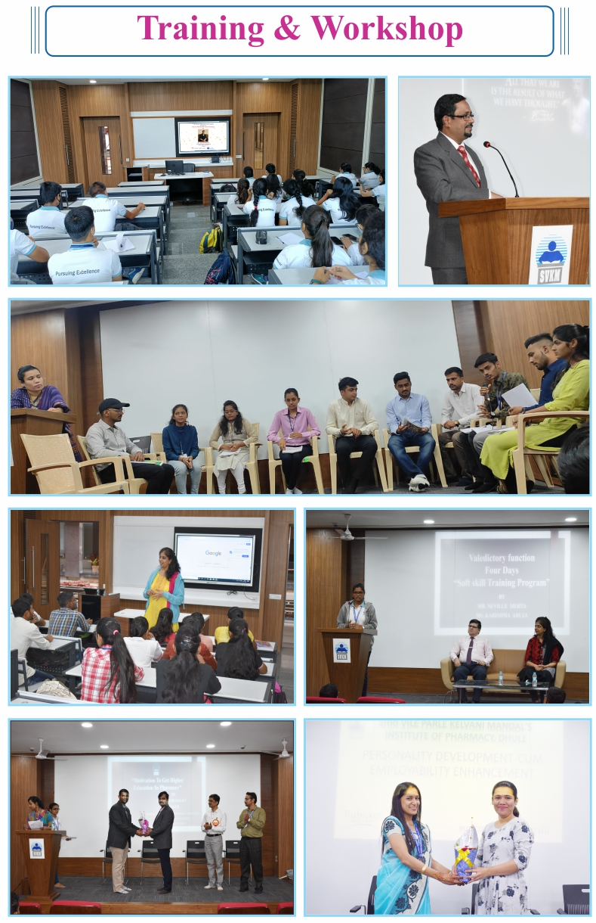
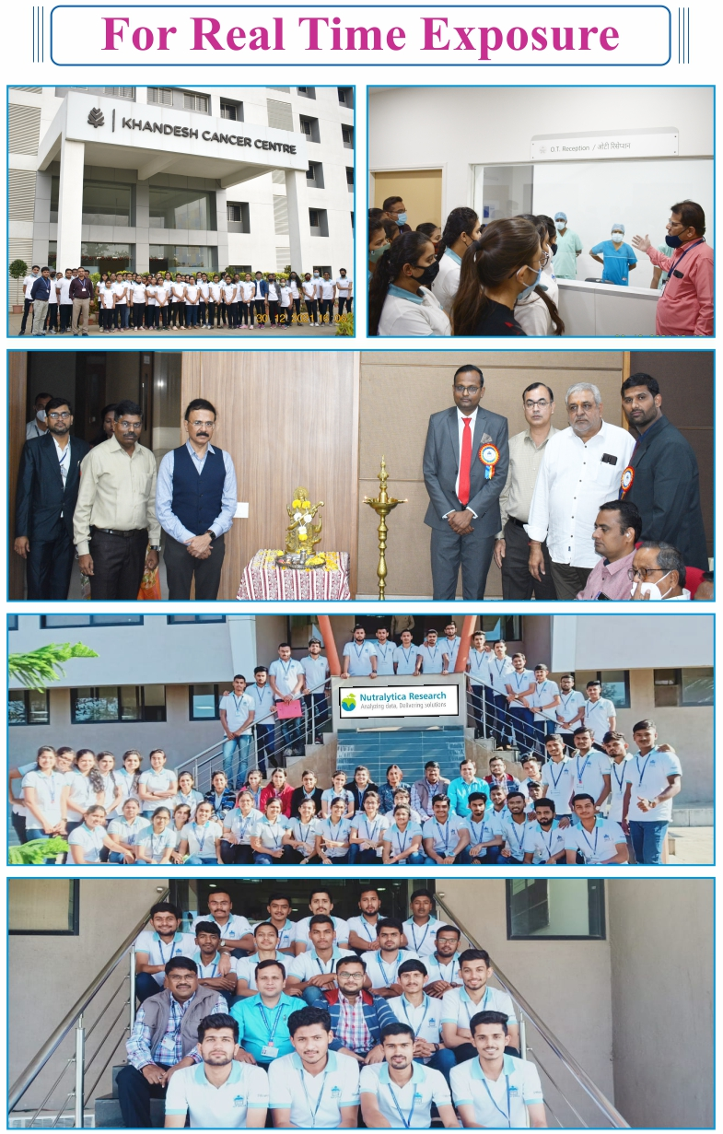
Bulletin

Slide 20
SVKM IOP DHULE
Precede.Pursue.Preeminence
Dr. Sammer Goyal, Principal SVKM’s
IOP, rreceived “Pharmainnova Award”
One-day seminar sponsored by Maharashtra State
Commission for Women on “Current Paradigms of Women Health Care”
Expert Lecture on personality development
through Positive Attitude-Key to Success
Soft Skill Training Workshop” By Corporate soft skill
trainer Mr. Neville Mehta & Ms. Karishma Ahuja.
Cultural Event at SVKM’s Institute of Pharmacy, Dhule
Cultural Event at SVKM’s Institute of Pharmacy, Dhule

Slide 21
SVKM IOP DHULE
Precede.Pursue.Preeminence

Slide 22
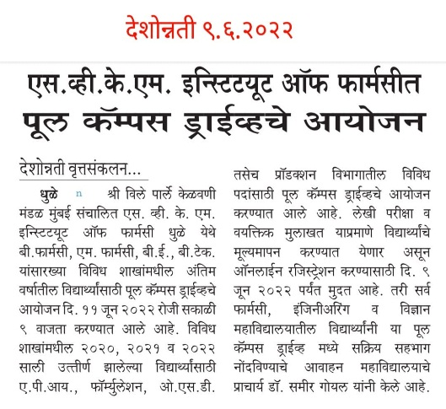
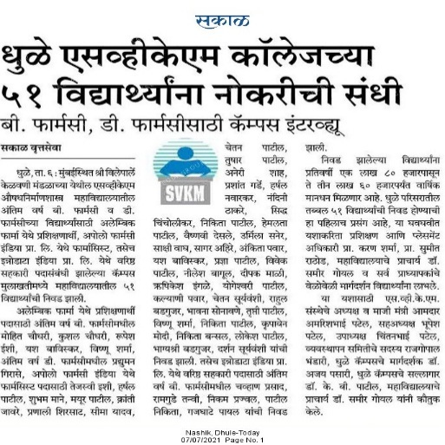
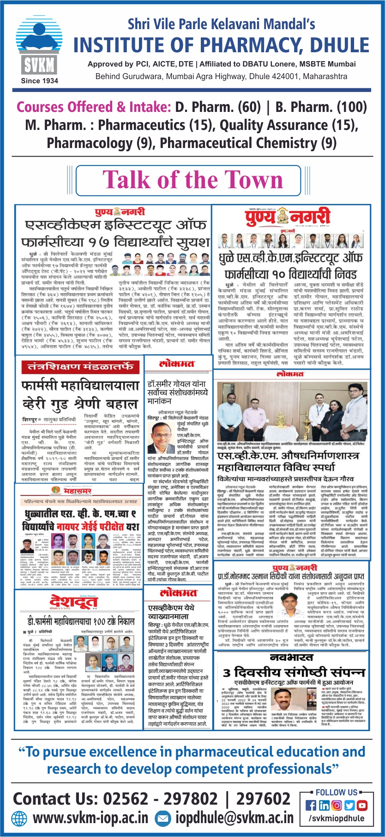
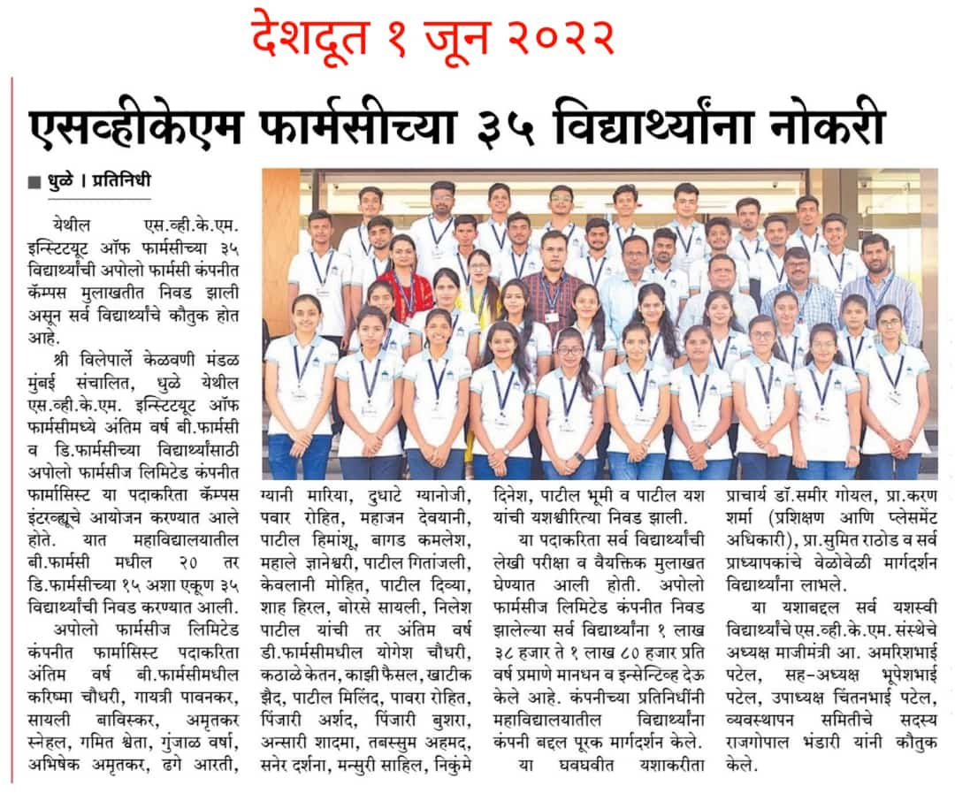
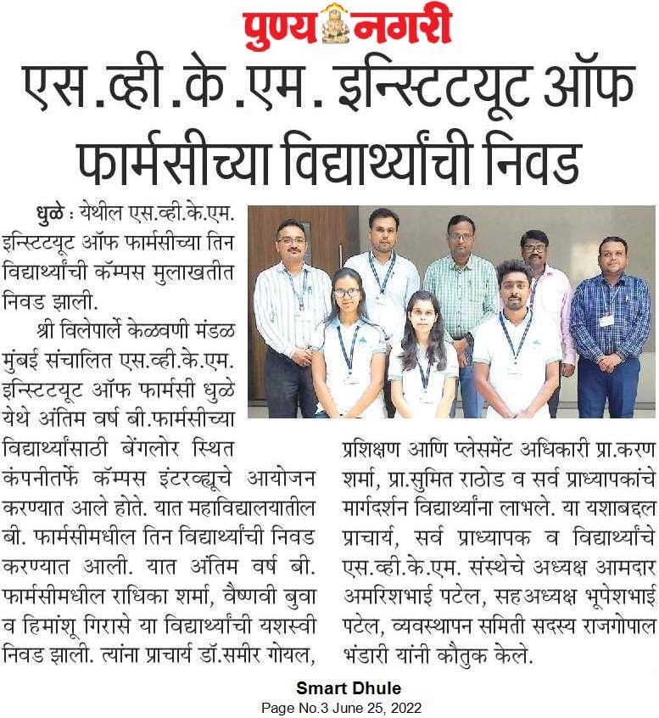
Newsletters

Slide 23
Why to recruit from SVKM IOP Dhule?
About our graduates
Our courses are designed with industry input and we work with national, international, and local businesses. Our courses are taught by professionals with industrial experience, so you can rely on our graduates possessing the inbuilt skills they need to succeed and the confidence to use them.
Developing employability skills is the heart of our Institute. In SVKM IOP Dhule we refer to these skills as the Nine Employability Capabilities and they are an integral part of the courses offered at the institute:
Management of self and own performance
Professional values
Communication skills and presentation of self
Team and customer working
Problem solving and decision making
Innovation and enterprise
Information and digital literacy
Financial literacy
Business and commercial awareness
Our major focus is to “develop competent professionals” by bridging industry academia gap through excellent tech-savvy teaching - learning pedagogy

Slide 24
Contact Us
Mr. Karan K. Sharma
Training and Placement Officer
Email:- karan.sharma@svkm.ac.in
Contact No: - +91- 9403178615
LinkedIn: - www.linkedin.com/in/karan-sharma-9918878b
Mrs. Barkha Agrawal
Asst. Training and Placement Officer
Email: - barkha.agrawal@svkm.ac.in
Shri Vile Parle Kelavani Mandal’s
Institute of Pharmacy, Dhule
Approved by AICTE, PCI, DTE
Affiliated to DBATU, Lonere, MSBTE, Mumbai
Survey No. 499, Plot No 03, Behind Gurudwara, Mumbai Agra National Highway, Dhule -424 001, Maharahstra, India
Mail us at: - IOPDhule@svkm.ac.in
Website: - www.svkm-iop.ac.in
Contact No:- 02562-297802
SVKM IOP DHULE
Precede.Pursue.Preeminence

